Slide 1

The Common Swift (Apus apus)
Reference images of the natural history scientific collection

Slide 2
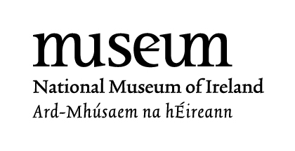
Teacher Information
The following images are of natural history scientific collections (i.e. taxidermy or stuffed animals) from the National Museum of Ireland – Natural History.
The collections of the Museum have been used for generations by scientists and artists to research and get up close to the natural word. These images are to be used as an educational tool in the classroom. For example, they can be used as a primary source for art to help pupils and students get a better idea of what the bird looks like, especially as swifts are migratory and only visit Ireland during the summer months.
For more age-appropriate information on taxidermy please visit Learn About: Stuffed Animals on www.museum.ie
Select the Notes Page within the View Toolbar to discover some extra information on some of the slides.
These images were taken by the Education Department at the National Museum of Ireland – Natural History.
These images are copyright of the National Museum of Ireland.
If you have any questions about the resource, please contact educationnh@museum.ie

Slide 3
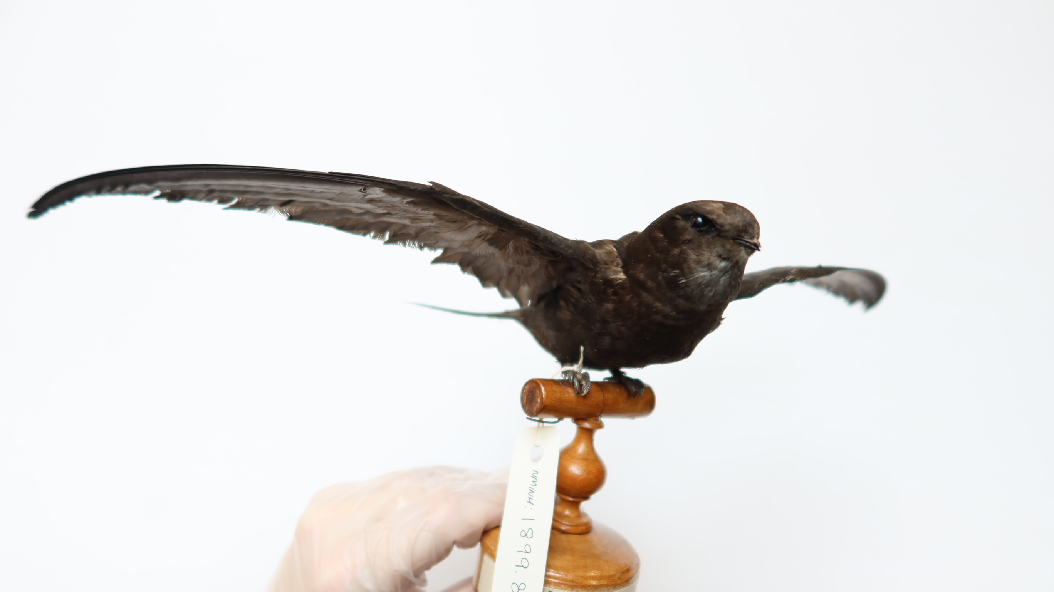
This is a common swift and a taxidermy display at the Museum.
Notes:
This taxidermy bird was on display in the Irish Room Exhibition for all visitors to see.
The National Museum of Ireland – Natural History closed its doors in September 2024 to begin major refurbishment and conservation works.
This taxidermy bird will soon be on display again at a temporary exhibition in the Museum’s sister site in Collins Barracks and is due to open in Spring 2025.
This taxidermy display is very old. It is a male and was found in Dublin and donated to the Museum in 1899 – one hundred and twenty-five years ago!

Slide 4
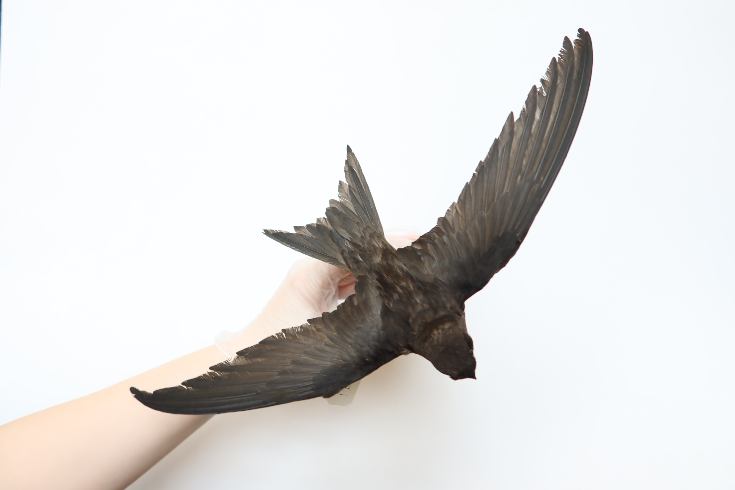
It has been created to look like it is in flight.
Notes:
Taxidermy is used at the Museum to preserve (or protect from decay) an animal’s body by mounting or stuffing it.
The taxidermy is then used as a unique display to look at and study up-close.
A person called a taxidermist creates the display.
Most of the taxidermy in the collections of the Museum are hundreds of years old.
It is the Museum’s job to care and look after the collections so that in years to come people can still see them and learn from them.
To learn more about taxidermy at the National Museum of Ireland – Natural History visit our website www.museum.ie for more resources including videos. (See link in Teacher Information Slide)

Slide 5
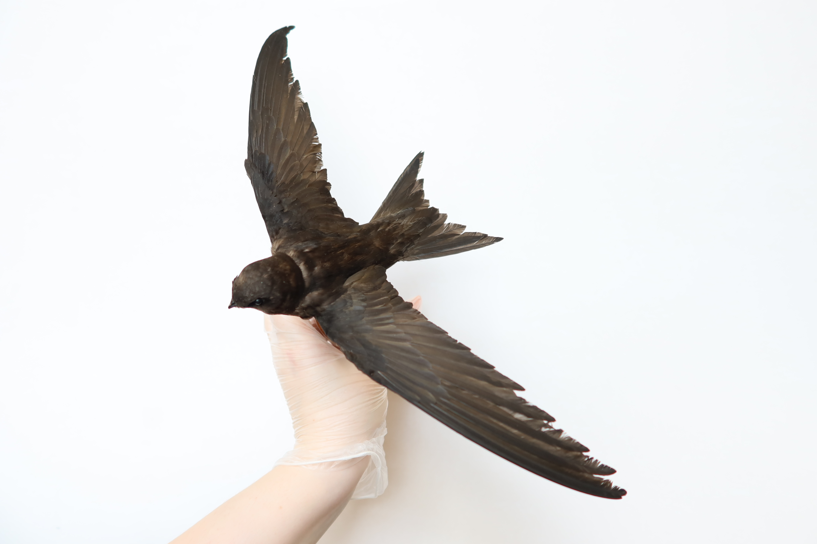
Can you see its long, curved wings?
Notes:
Its long crescent shaped wings helps the bird to maneuver quickly in flight, turning here, there and everywhere!
It is also one of the fastest birds in the world – with a powered flight of up to 113 kph!
It uses its strong and agile wings to fly thousands of kilometers each summer as it migrates from South Africa to Ireland.
The best time to see swifts in the wild in Ireland is May, June and July.

Slide 6
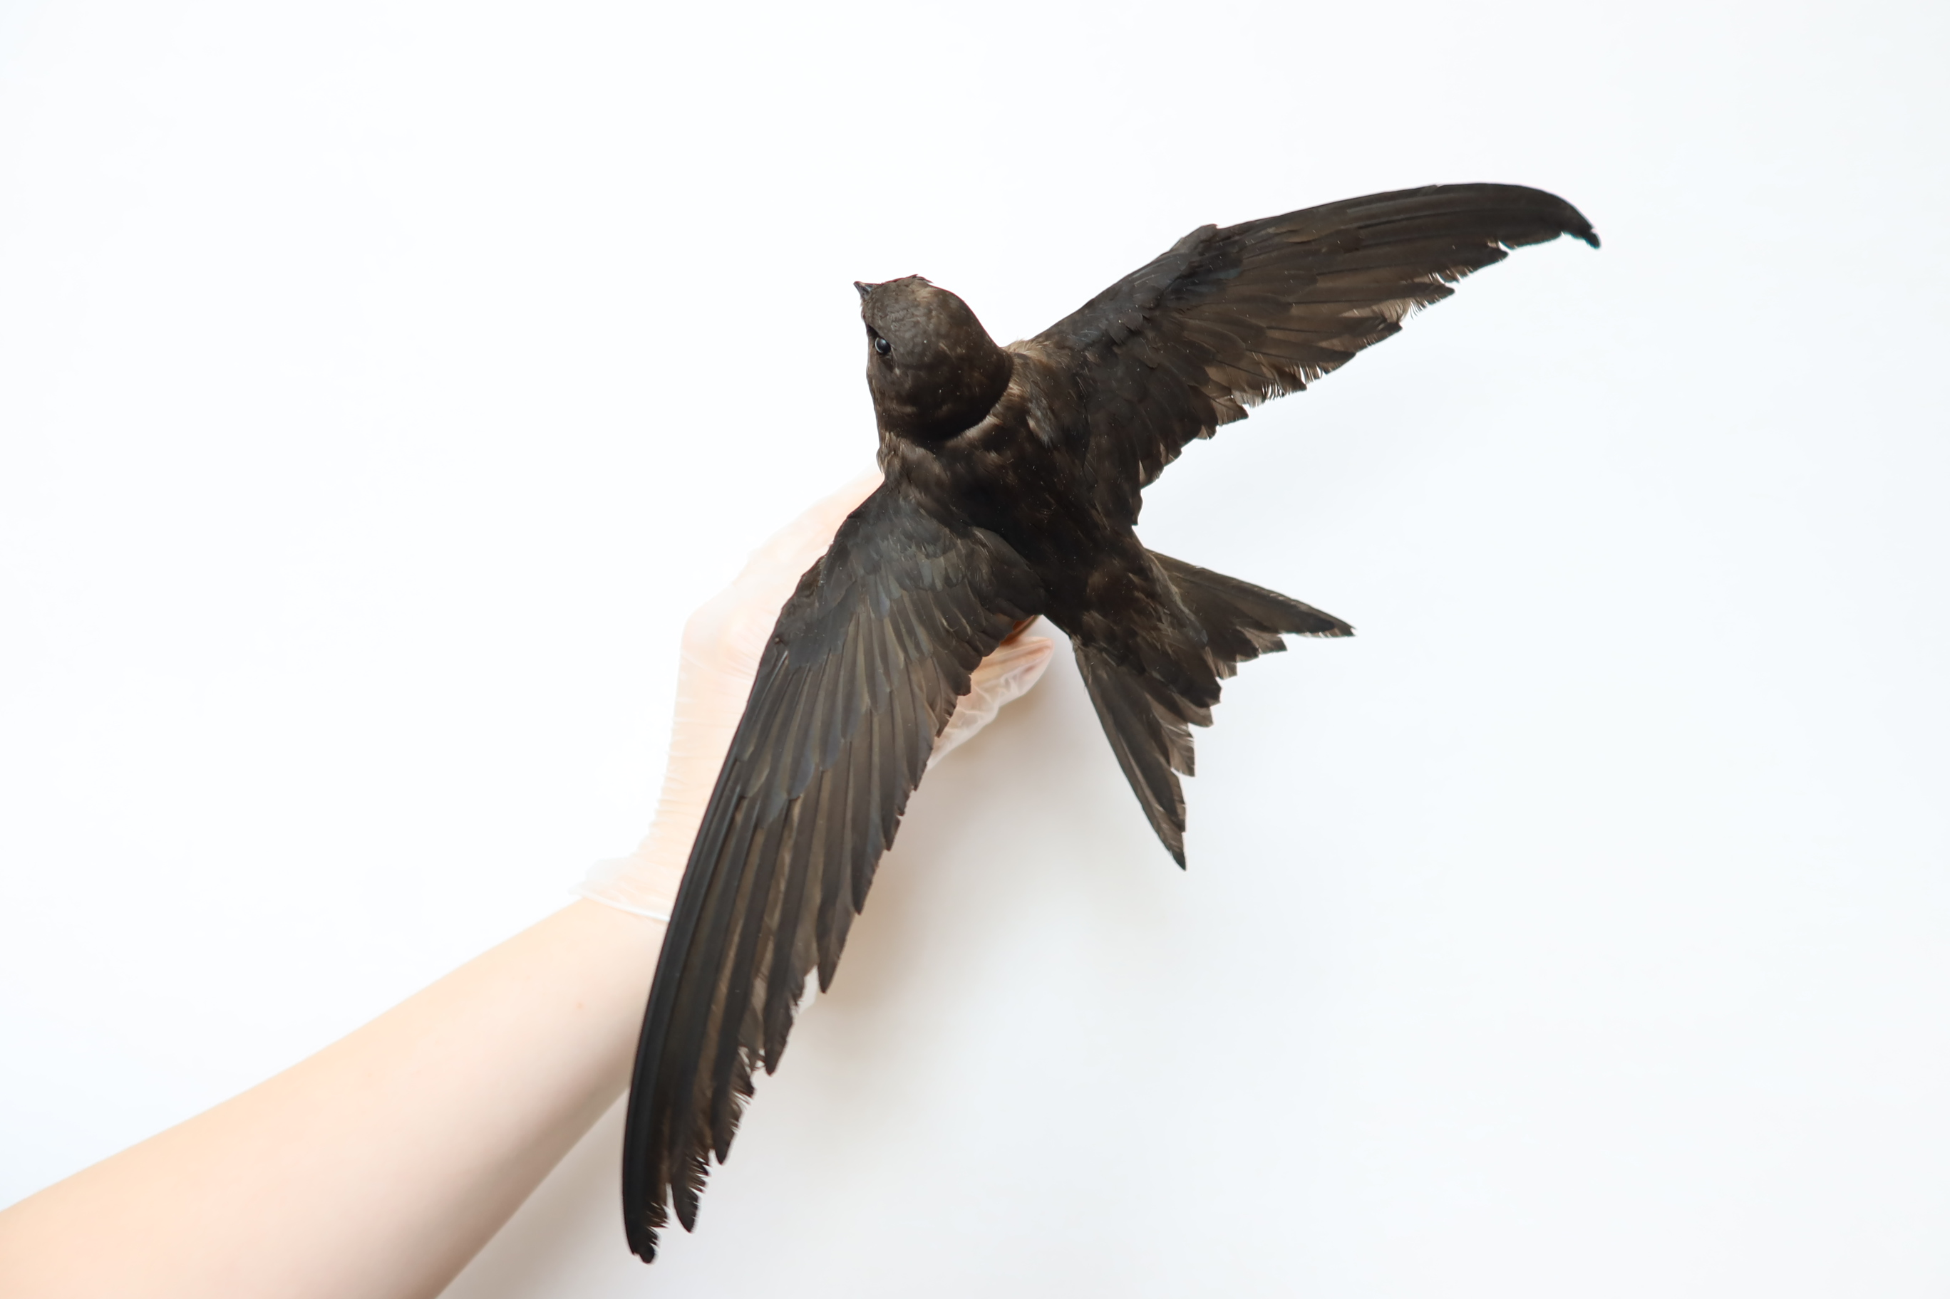
Look at its forked tail, short body and small head.
Notes:
The common swift’s body and tail length is between 16 -17cm long.
As you can see from the image its wingspan is even longer and can be as long as 38 – 40cm.
In this picture the swift’s forked tail is fanned.

Slide 7
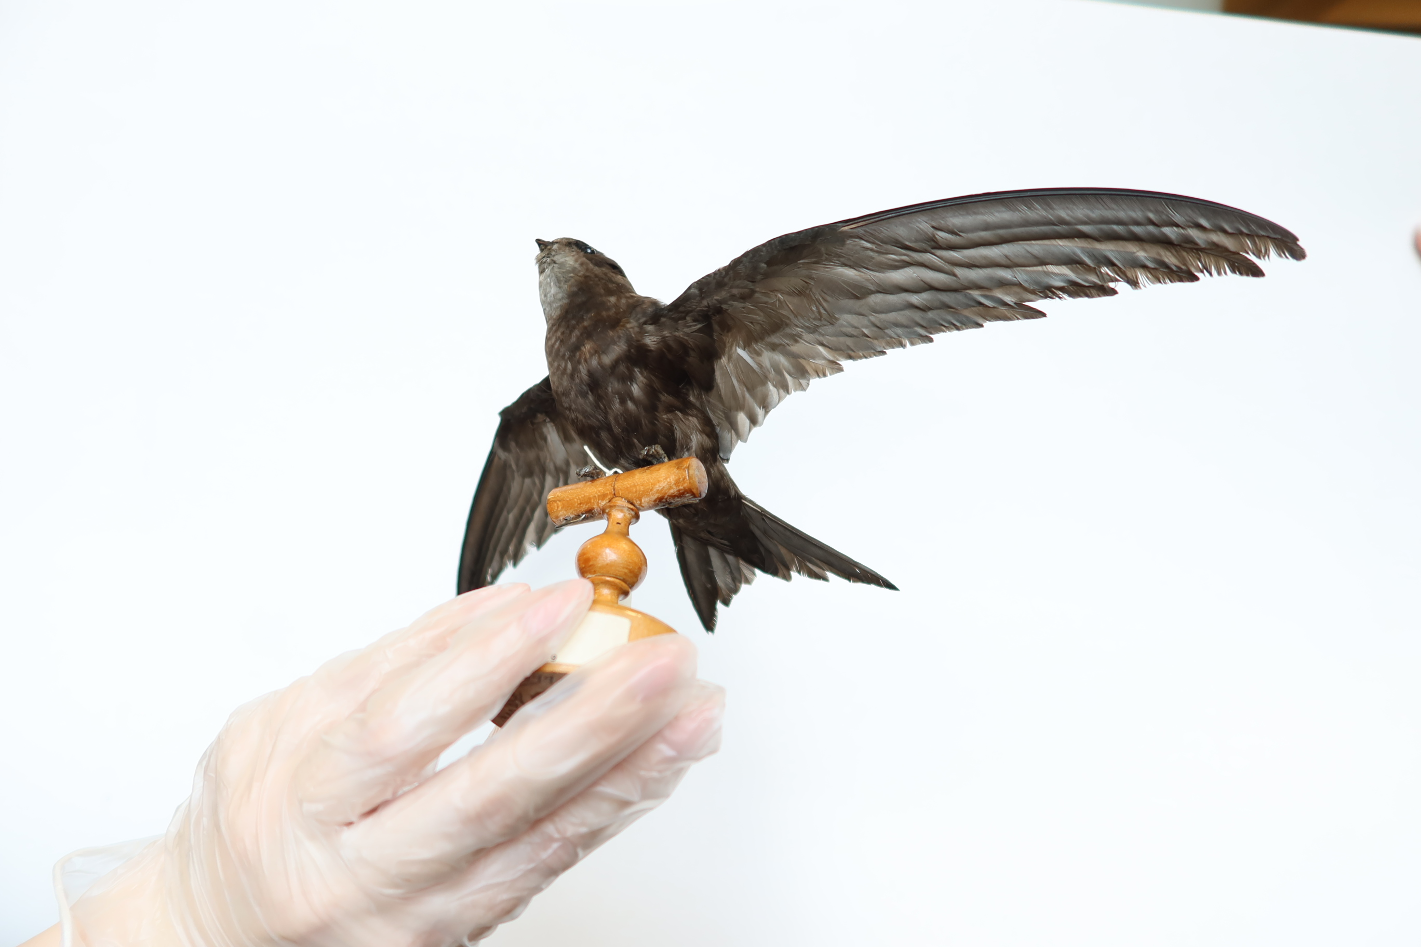
Zoom in on the image to see the feathers on the wings up- close.

Slide 8
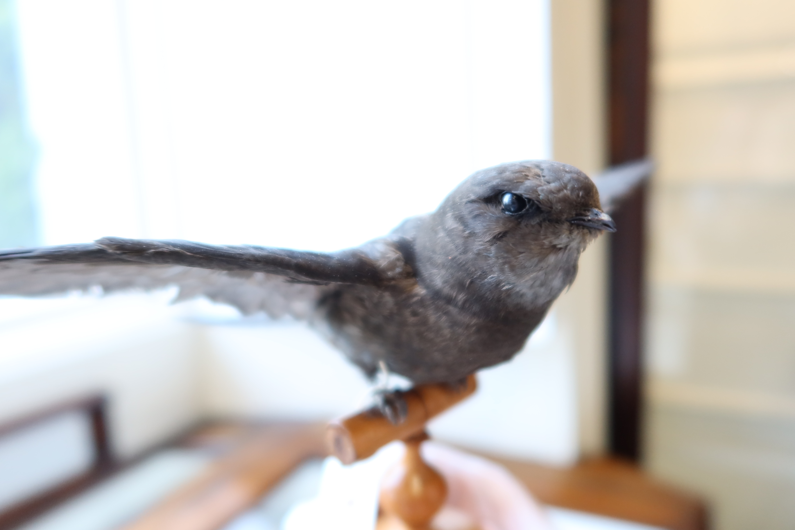
This is a close-up of the swift’s small head and beak

Slide 9
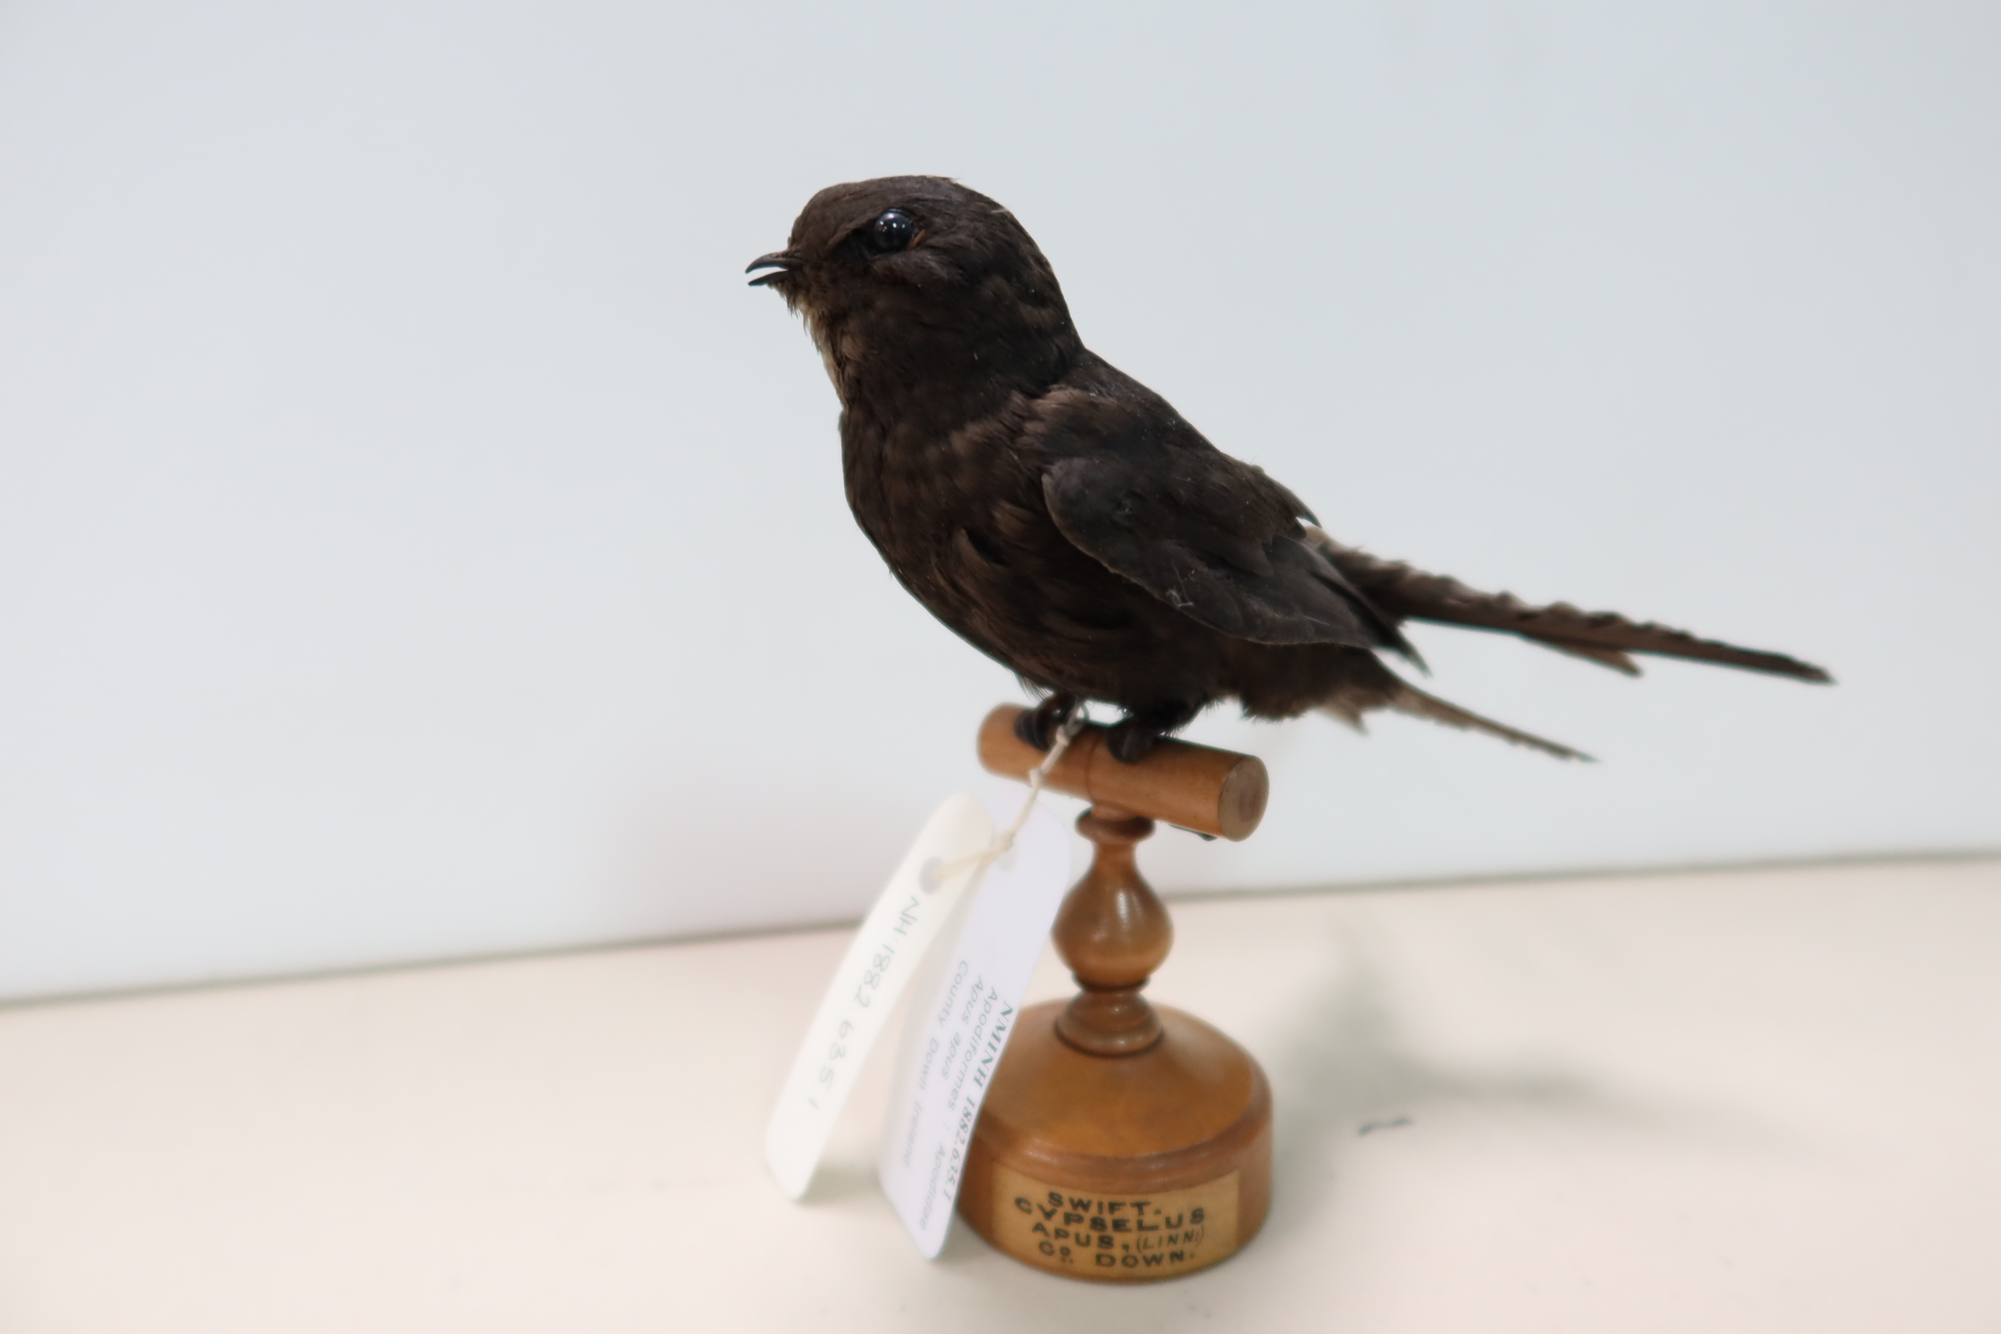
This is a different swift – it is displayed perched with its short legs on a stand.
Notes:
This swift was found in Co. Down and has been in the Museum collections since 1882. It’s even older than the last display!

Slide 10
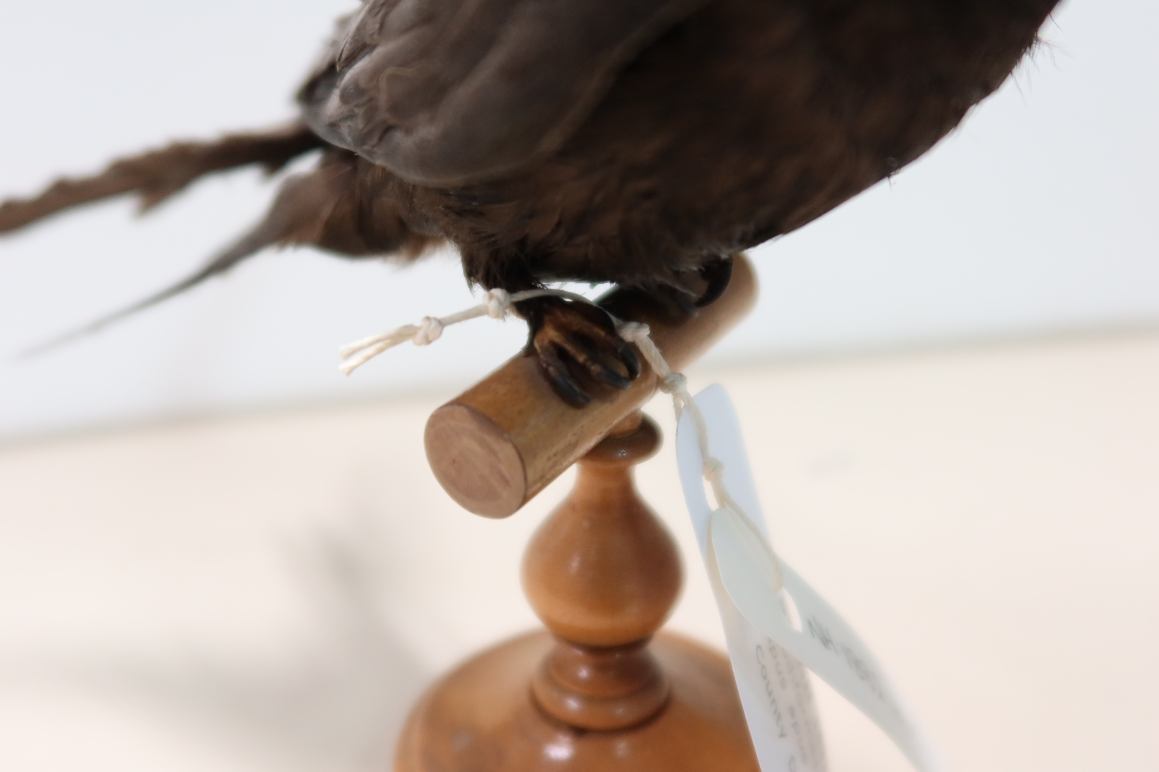
Can you see its four claws? Read the notes below to learn more about swift feet!
Notes:
Important Facts about common swift’s legs and feet!
The common swift’s scientific name, Apus apus, means ‘without legs’.
Swifts’ legs are very short and small and as they spend most of their time flying people in the past used to think they did not have any legs!
The taxidermy swift in the image has been modeled to look like it is perching but in real life swifts cannot perch on electrical wires, trees or, in fact, anything. This is because they literally can’t do it due to the shape of their feet and claws.
Instead, they have adapted to cling to vertical surfaces like the face of a cliff or wall of a house.
As you can see in the image, all four claws face to the front, which helps the bird to cling vertically to walls but not perch or walk around on the ground.

Slide 11
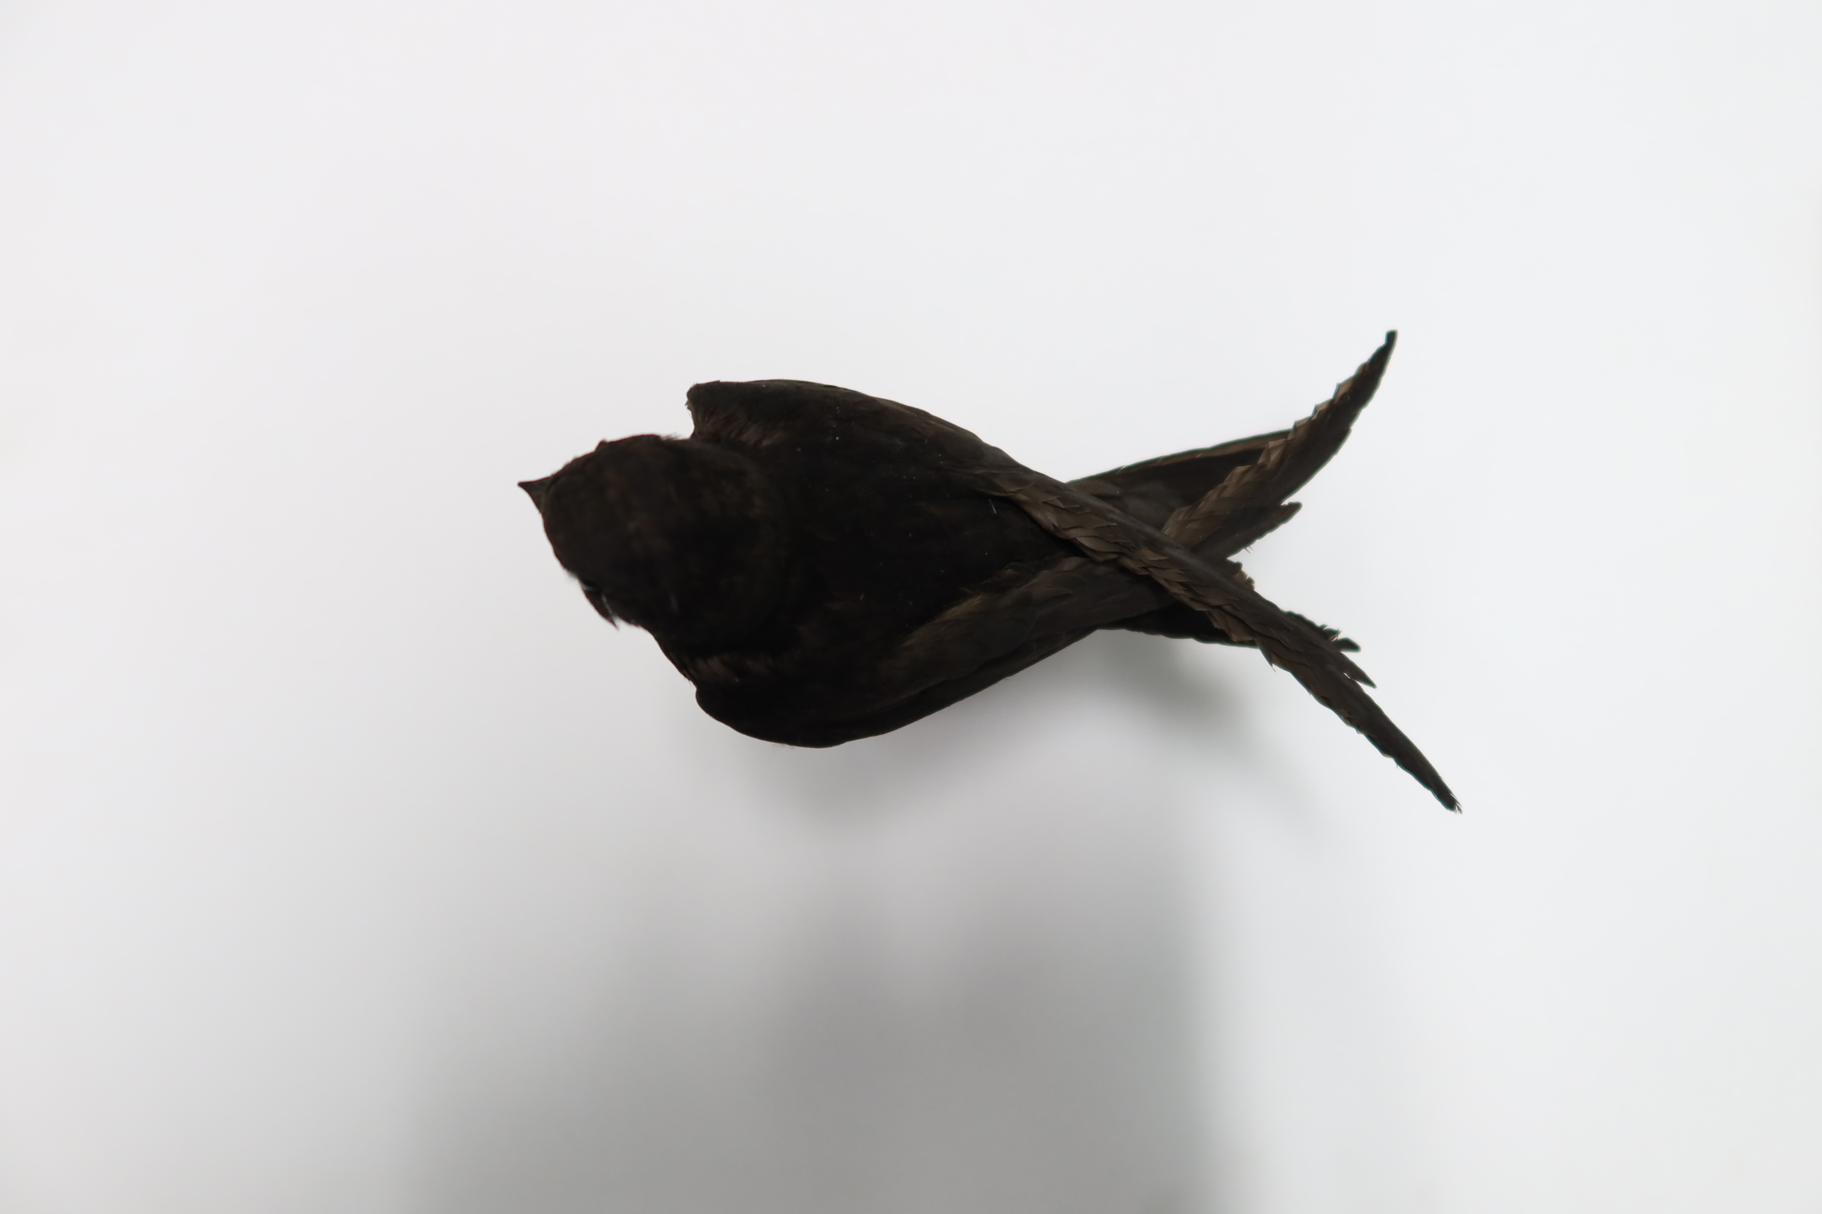
This is what it looks like from above. See how the wings fold over?

Slide 12
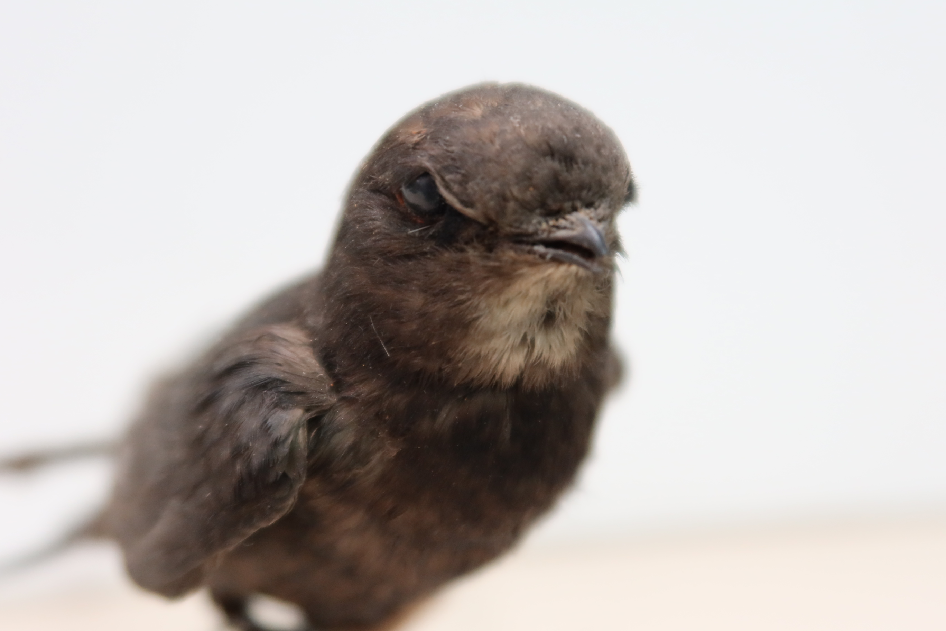
This is a close-up of its beak and pale patch (chin patch) on its throat.

Slide 13
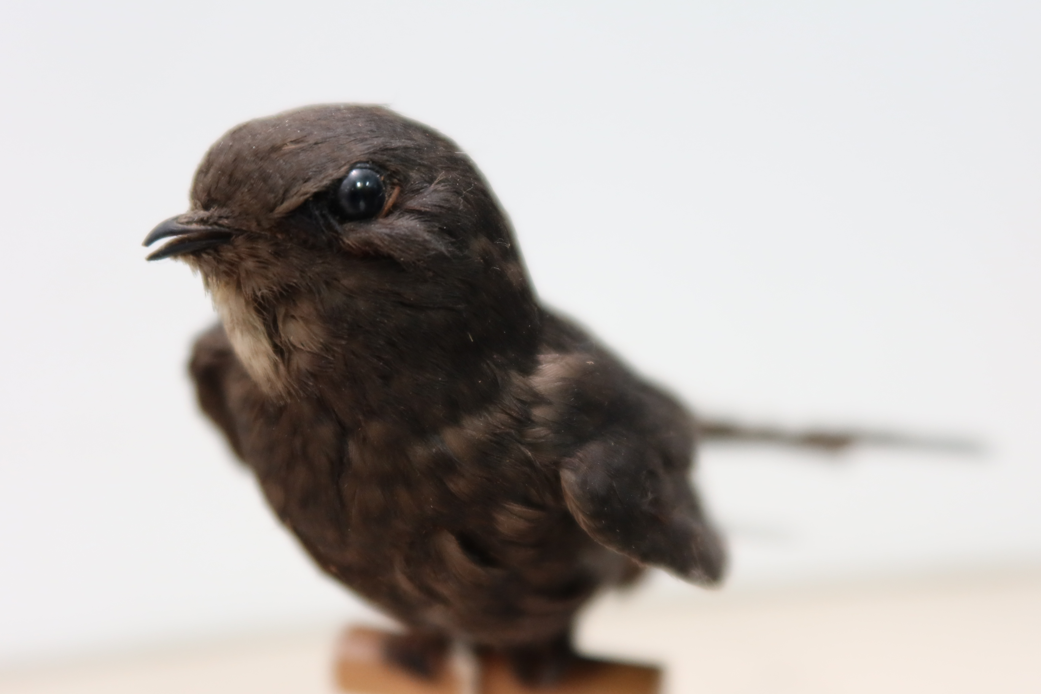
Can you see its eyes? All taxidermy have fake glass eyes.

Slide 14
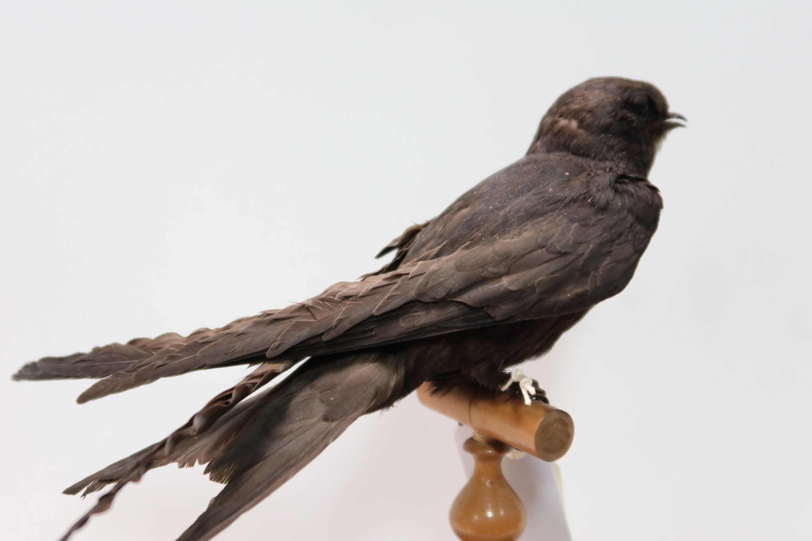
We hope you find these images helpful and good luck with the art competition! Bye bye!

